Slide 1
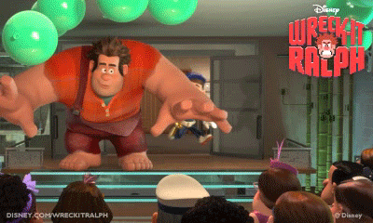
I’m a strong and tall man
“Wreck-it Ralph”.
I’m Felix.
I’m a thin and short boy.
Who are you?

Slide 2
-en
-et

Slide 3
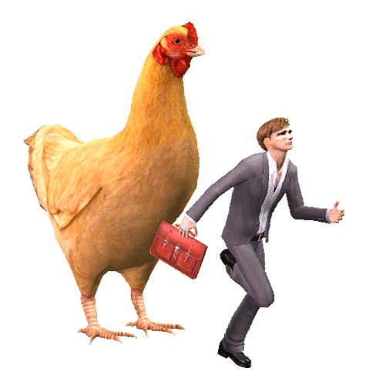
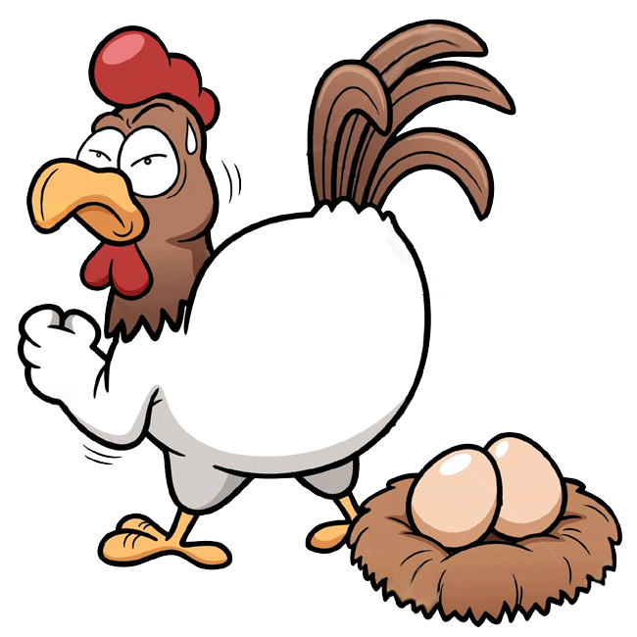
h
en

Slide 4
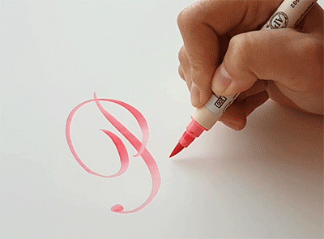
p
en

Slide 5
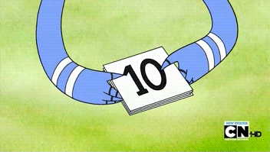
t
en

Slide 6
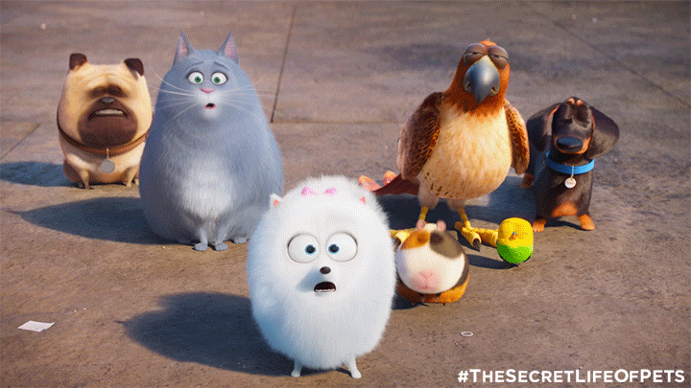
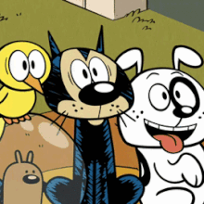
p
et

Slide 7
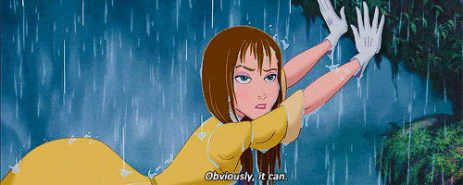
w
et

Slide 8
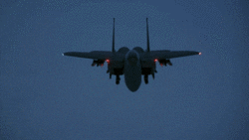
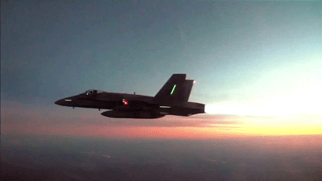
j
et

Slide 9
en
et
hen
pen
ten
pet
wet
jet

Slide 10
Ben has a hen.

Slide 11
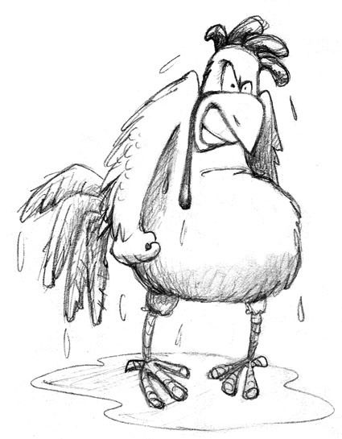
The hen is wet.

Slide 12
The wet hen with a pen is Ben’s pet.

Slide 13
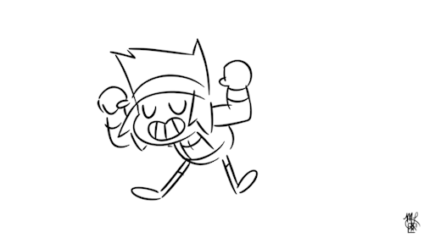

Slide 14
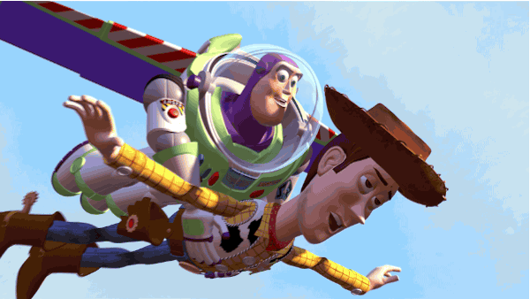
Hi! My name is Buzz.
I’m a short and strong boy.
I’m Woody.
I’m a tall and thin boy.

Slide 15
a boy

Slide 16
a girl

Slide 17
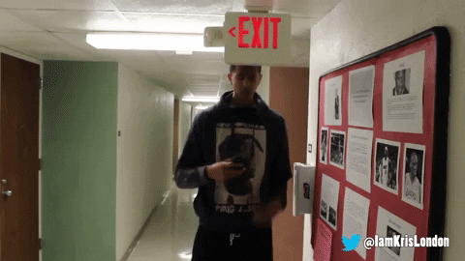
tall

Slide 18
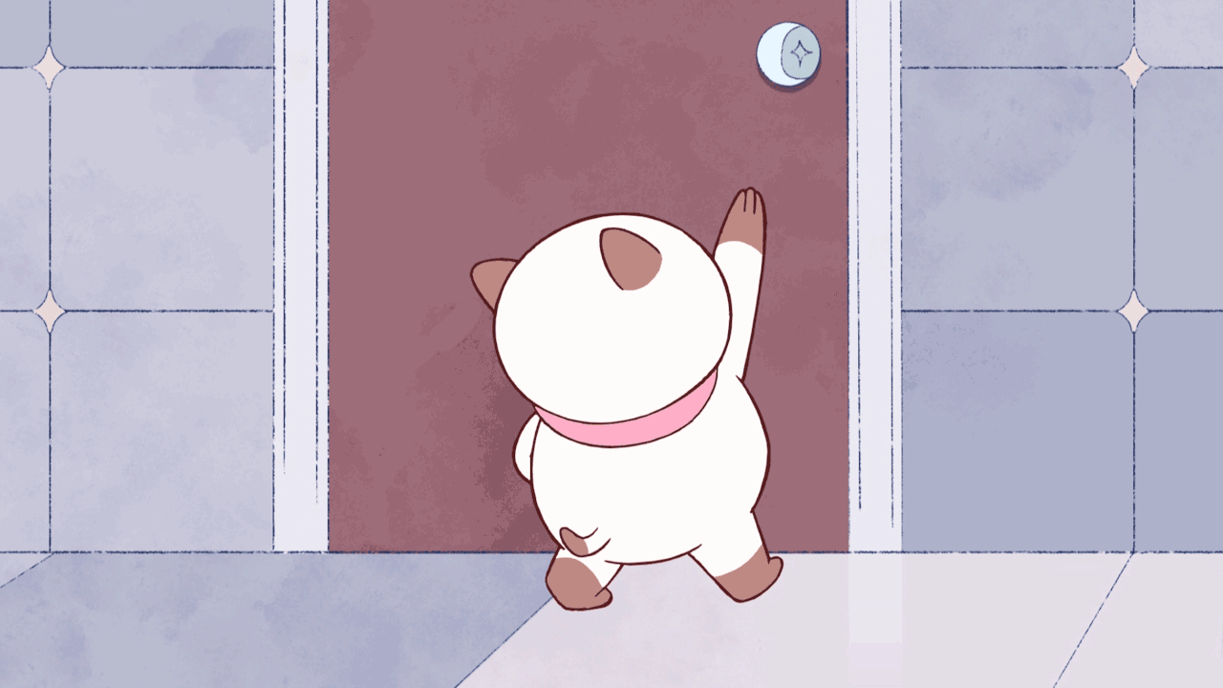
short

Slide 19
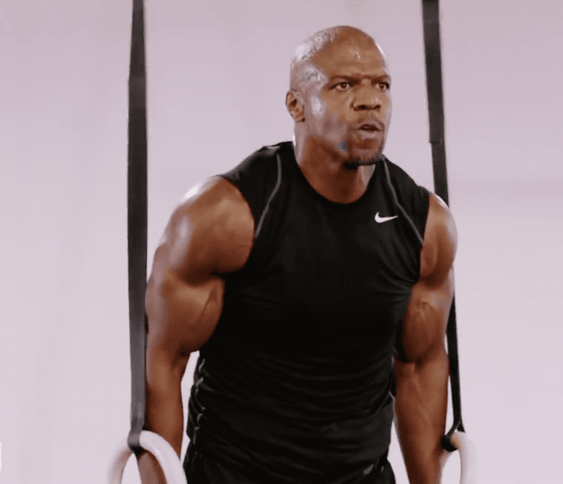
strong

Slide 20
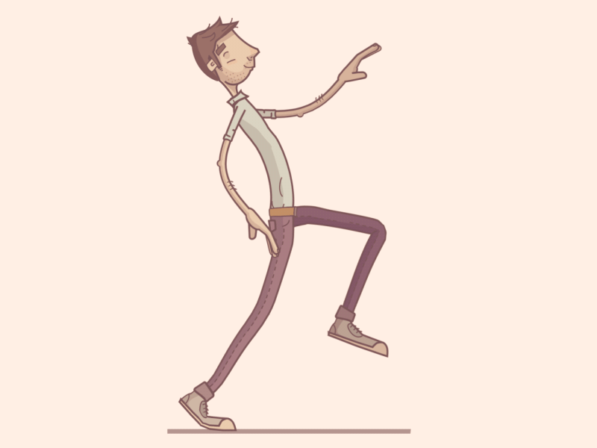
thin

Slide 21
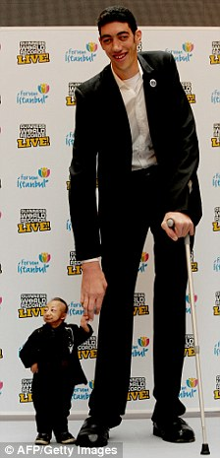
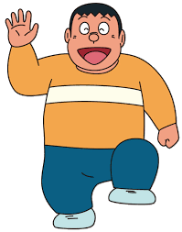
tall
strong
a boy
a girl
thin
short

Slide 22
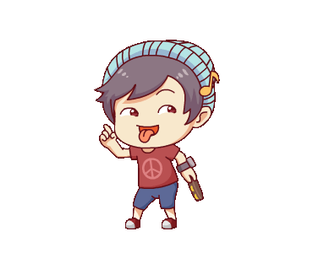
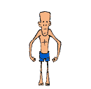
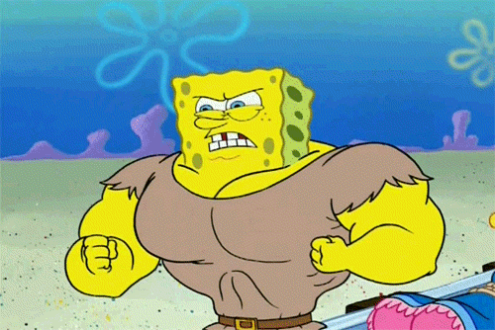
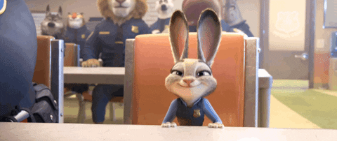
1
2
3
a boy
a girl
tall
4
5
6
short
strong
thin

Slide 23
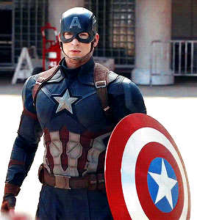
Are you strong?
Yes, I am.
I am strong.

Slide 24
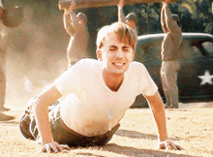
Are you strong?
No, I’m not.
I am thin.

Slide 25
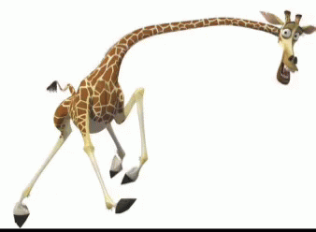
Are you tall?
Yes, I am.
I am tall.

Slide 26
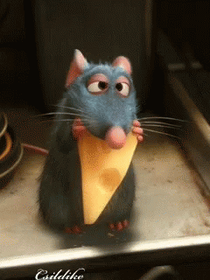
Are you tall?
No, I’m not.
I am short.

Slide 27
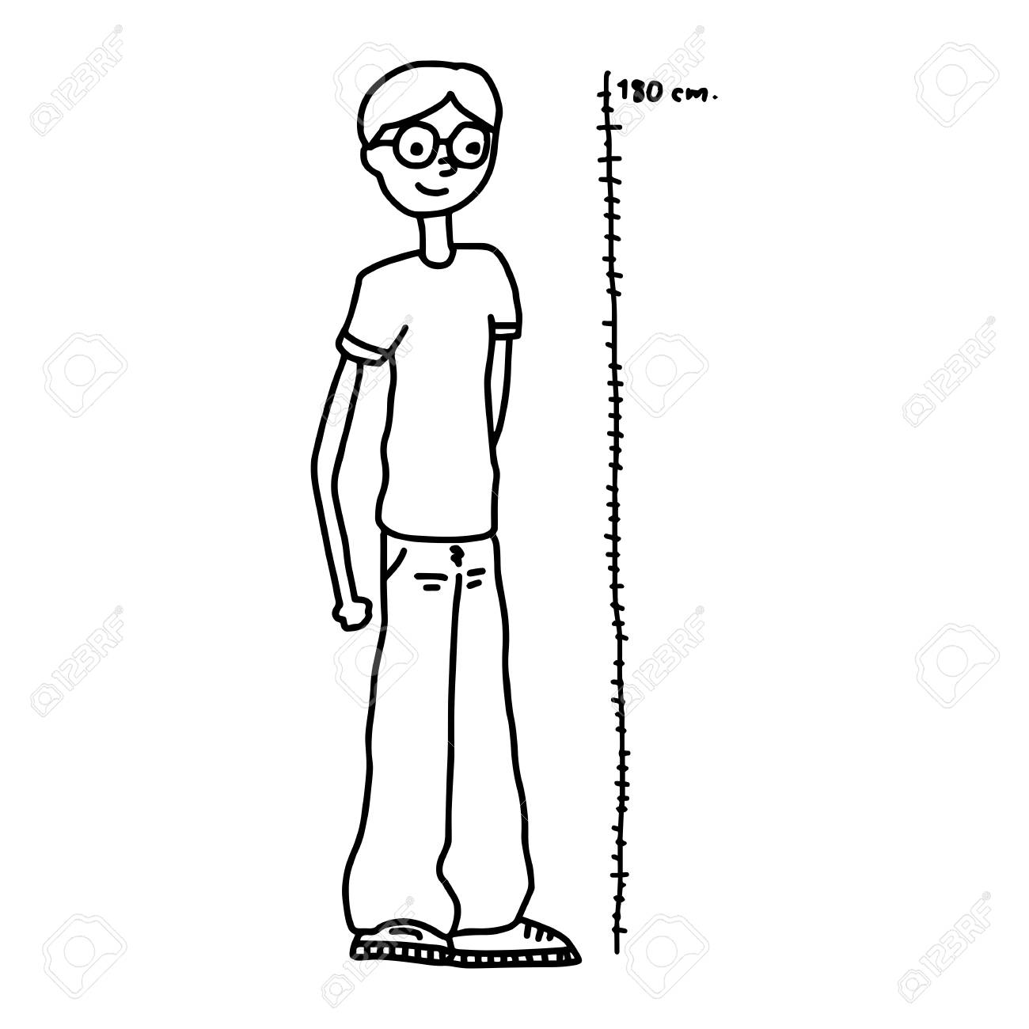
Are you a boy?
Yes, I am.
I am a tall boy.

Slide 28
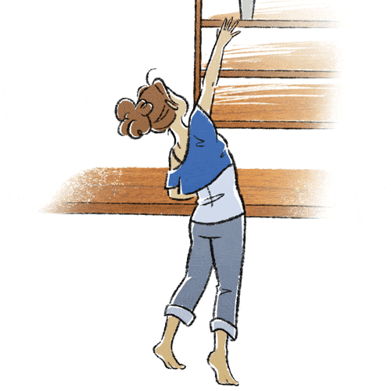
Are you a girl?
Yes, I am.
I am a short girl.

Slide 29
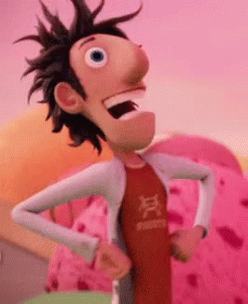
Are you a strong boy?
No, I’m not.
I am a thin boy.

Slide 30
Are you a thin girl?
No, I’m not.
I am a
strong girl.

Slide 31
Attention!!!
I am= I’m.
Yes, I am.中的I am
不可以縮寫。

Slide 32
Homework this week
聽: CD1第41-44首。
說&讀:聽CD時跟著大聲唸。完成3遍
請家長在課本P28簽名，可換印章。
寫:英語習作P45-P46。

Slide 34
l
t
a
l

Slide 35
b
a
y
o

Slide 36
r
t
g
o
n
s

Slide 37
r
i
a
g
l

Slide 38
n
i
h
t

Slide 39
s
o
t
r
h

